Slide 1
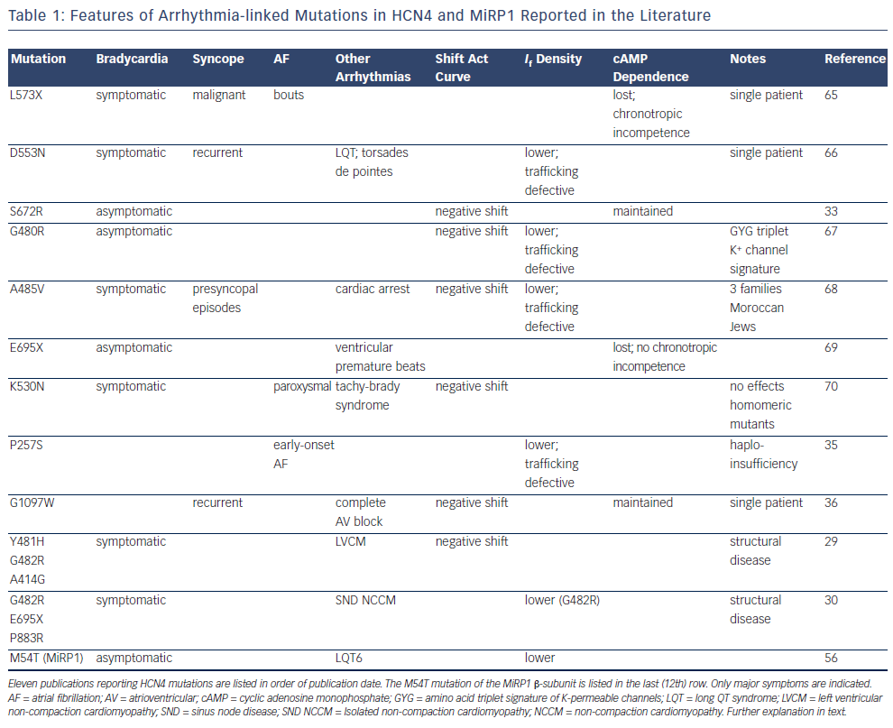
DiFrancesco D
Features of Arrhythmia-linked Mutations in HCN4 and MiRP1 Reported in the Literature
Citation: Arrhythmia & Electrophysiology Review 2015;4(1):9-13
https://doi.org/10.15420/aer.2015.4.1.1

