Slide 1
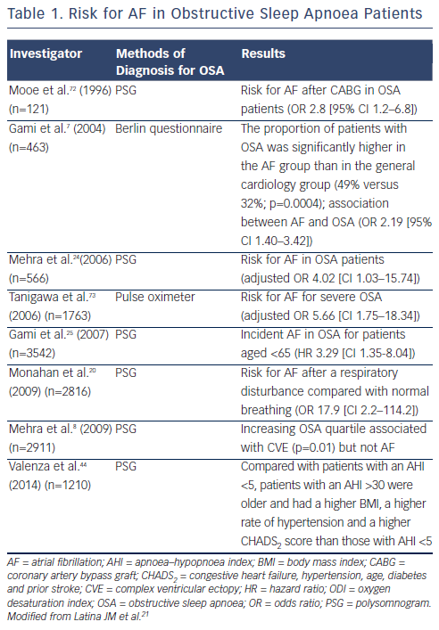
Zhang L, Hou Y, Po SS
Risk for AF in Obstructive Sleep Apnoea Patients
Citation: Arrhythmia & Electrophysiology Review 2015;4(1):14-8
https://doi.org/10.15420/aer.2015.4.1.14

