Slide 1
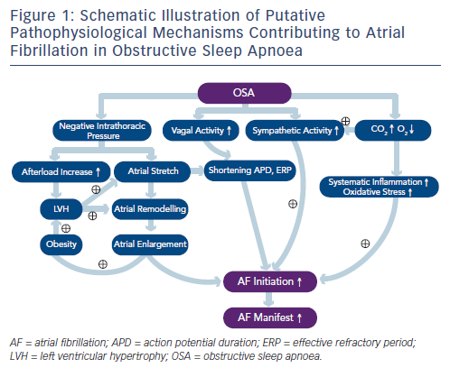
Zhang L, Hou Y, Po SS
Schematic Illustration of Putative Pathophysiological Mechanisms Contributing to Atrial Fibrillation in Obstructive Sleep Apnoea
Citation: Arrhythmia & Electrophysiology Review 2015;4(1):14-8
https://doi.org/10.15420/aer.2015.4.1.14

