Slide 1
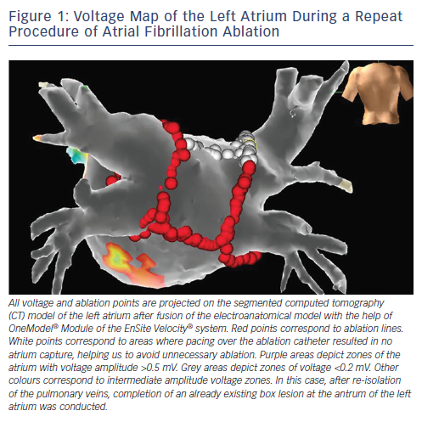
Koutalas E, Dinov B, Richter S, Bollmann A, Hindricks G, Sommer P
Voltage Map of the Left Atrium During a Repeat Procedure of Atrial Fibrillation Ablation
Citation: Arrhythmia & Electrophysiology Review 2015;4(1):19-27
https://doi.org/10.15420/aer.2015.4.1.19

