Slide 1
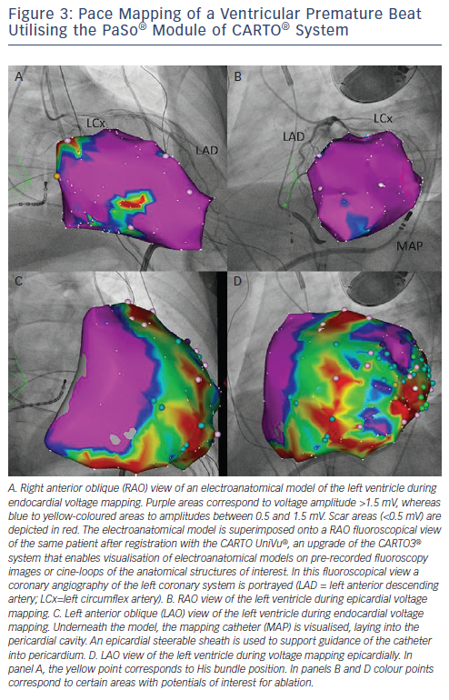
Koutalas E, Dinov B, Richter S, Bollmann A, Hindricks G, Sommer P
Pace Mapping of a Ventricular Premature Beat Utilising the PaSo® Module of CARTO® System
Citation: Arrhythmia & Electrophysiology Review 2015;4(1):19-27
https://doi.org/10.15420/aer.2015.4.1.19

