Slide 1
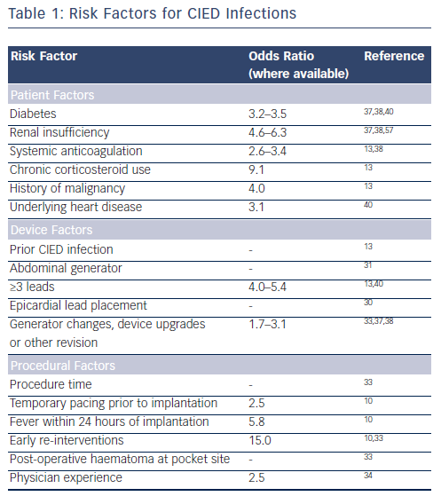
Kennergren C
Risk Factors for CIED Infections
Citation: Arrhythmia & Electrophysiology Review 2015;4(1):53-7
https://doi.org/10.15420/aer.2015.4.1.53

