Slide 1
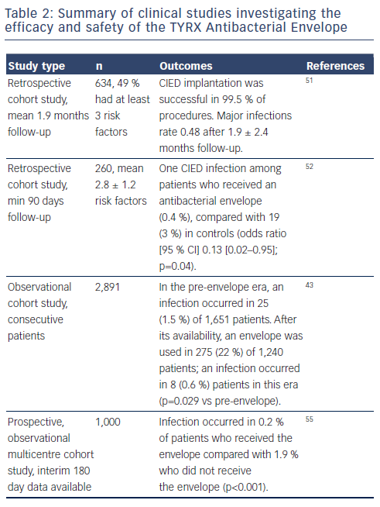
Kennergren C
Summary of clinical studies investigating the efficacy and safety of the TYRX Antibacterial Envelope
Citation: Arrhythmia & Electrophysiology Review 2015;4(1):53-7
https://doi.org/10.15420/aer.2015.4.1.53

