Slide 1
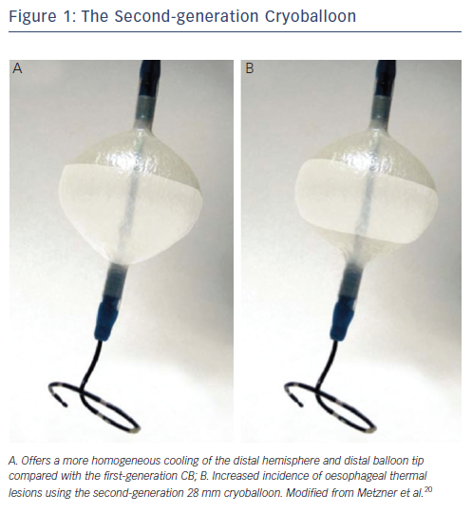
Metzner A, Wissner E, Lin T, Ouyang F, Kuck KH
The Second-generation Cryoballoon
Citation: Arrhythmia & Electrophysiology Review 2015;4(1):58-61
https://doi.org/10.15420/aer.2015.4.1.58

