Slide 1
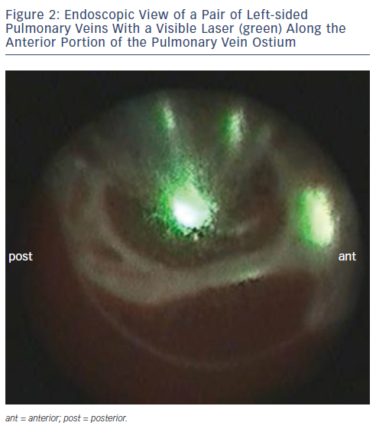
Metzner A, Wissner E, Lin T, Ouyang F, Kuck KH
Endoscopic View of a Pair of Left-sided Pulmonary Veins With a Visible Laser (green) Along the Anterior Portion of the Pulmonary Vein Ostium
Citation: Arrhythmia & Electrophysiology Review 2015;4(1):58-61
https://doi.org/10.15420/aer.2015.4.1.58

