Slide 1
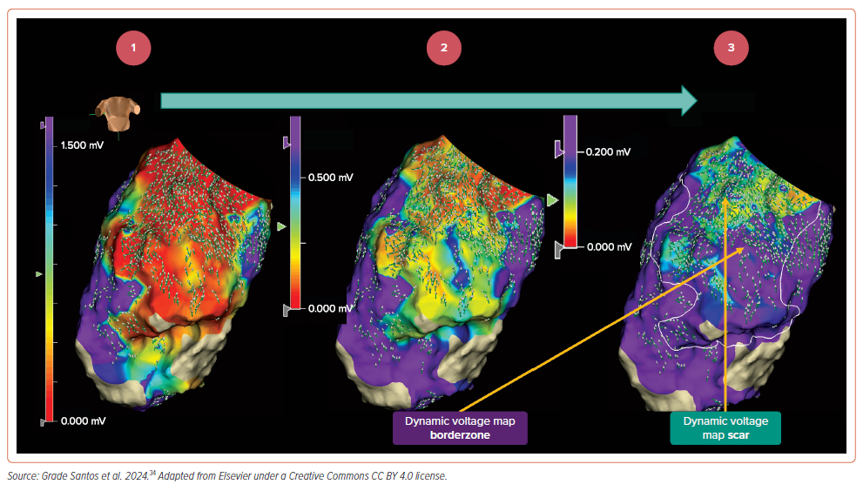
Mills MT, Calvert P, Chiong J, Gupta D, Luther V
Figure 5: Dynamic Voltage Mapping in EnSite X
Citation: Arrhythmia & Electrophysiology Review 2024;13:e16.
https://doi.org/10.15420/aer.2024.26

