Slide 1
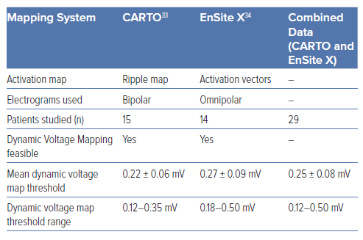
Mills MT, Calvert P, Chiong J, Gupta D, Luther V
Table 1: Findings from Previous Dynamic Voltage Mapping Studies
Citation: Arrhythmia & Electrophysiology Review 2024;13:e16.
https://doi.org/10.15420/aer.2024.26

