Slide 1
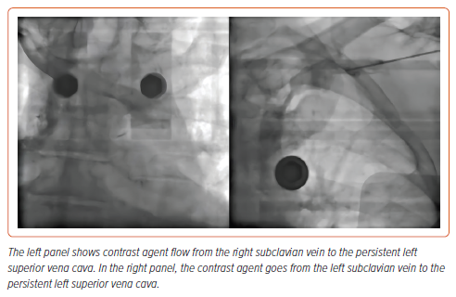
Bakytzhanuly A, Otegen T, Nuralinov O
Figure 1: Persistent Left Superior Vena Cava
Citation: Interventional Cardiology 2024;19:e19.
https://doi.org/10.15420/icr.2023.38

