Slide 1
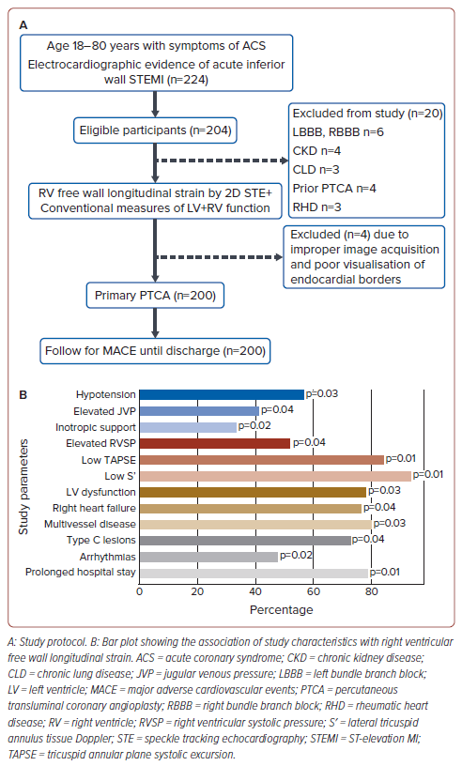
Rajendran K, Salam A, Vasu J
Figure 1: Study Protocol and Association of Characteristics with Right Ventricle Free Wall Longitudinal Strain
Citation: Journal of Asian Pacific Society of Cardiology 2024;3:e37.
https://doi.org/10.15420/japsc.2023.25

