Slide 1
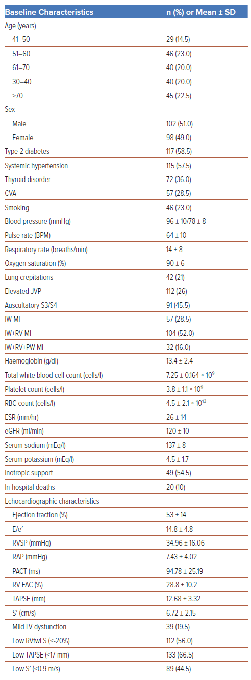
Rajendran K, Salam A, Vasu J
Table 1: Baseline, Echocardiographic and Angiographic Characteristics of the Study Population (n=200)
Citation: Journal of Asian Pacific Society of Cardiology 2024;3:e37.
https://doi.org/10.15420/japsc.2023.25

