Slide 1
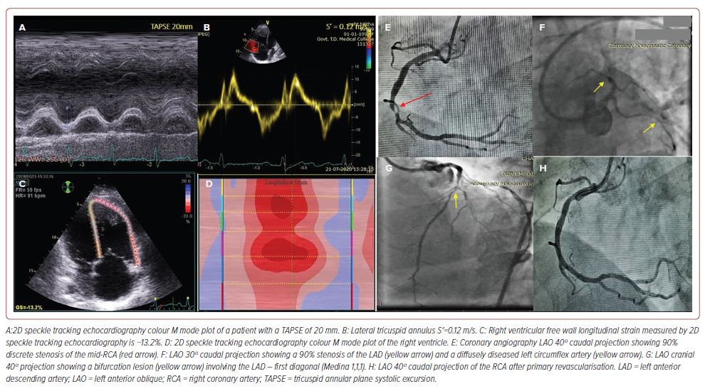
Rajendran K, Salam A, Vasu J
Figure 2: Significance of Low RVfwLS with Normal Conventional Echocardiographic Parameters in Triple Vessel Disease
Citation: Journal of Asian Pacific Society of Cardiology 2024;3:e37.
https://doi.org/10.15420/japsc.2023.25

