Slide 1
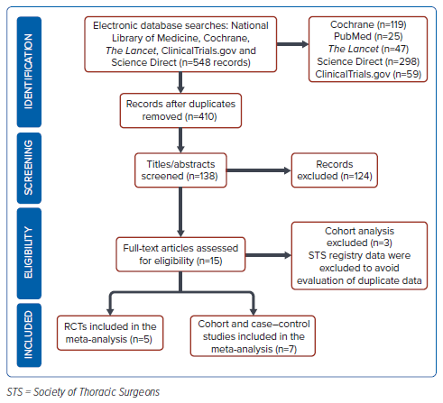
Tugade RER, Joseph David B, Tolentino CS
Figure 1: Preferred Reporting Items for Systematic Reviews and Meta-Analyses 2020 Flow Diagram
Citation: Journal of Asian Pacific Society of Cardiology 2024;3:e39.
https://doi.org/10.15420/japsc.2023.37

