Slide 1
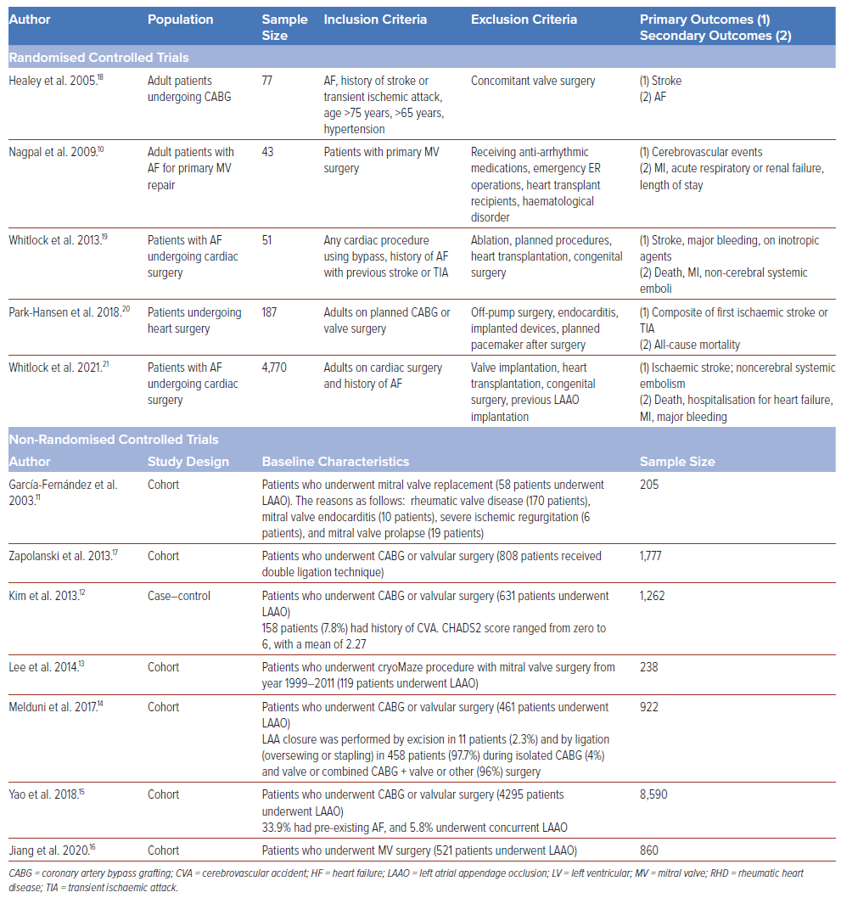
Tugade RER, Joseph David B, Tolentino CS
Table 1: Characteristics of the Included Studies
Citation: Journal of Asian Pacific Society of Cardiology 2024;3:e39.
https://doi.org/10.15420/japsc.2023.37

