Slide 1
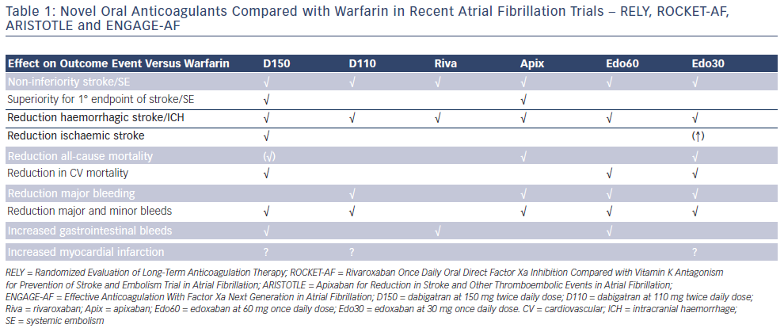
Plunkett O, Lip GY
Table 1: Novel Oral Anticoagulants Compared with Warfarin in Recent Atrial Fibrillation Trials – RELY, ROCKET-AF, ARISTOTLE and ENGAGE-AF
Citation: Arrhythmia & Electrophysiology Review 2014;3(1):40-3
https://doi.org/10.15420/aer.2011.3.1.40

