Slide 1
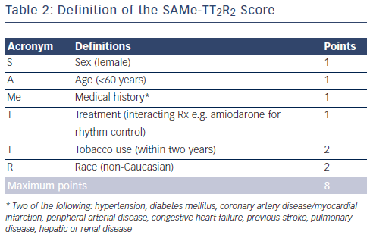
Plunkett O, Lip GY
Table 2: Definition of the SAMe-TT2R2 Score
Citation: Arrhythmia & Electrophysiology Review 2014;3(1):40-3
https://doi.org/10.15420/aer.2011.3.1.40

