Slide 1
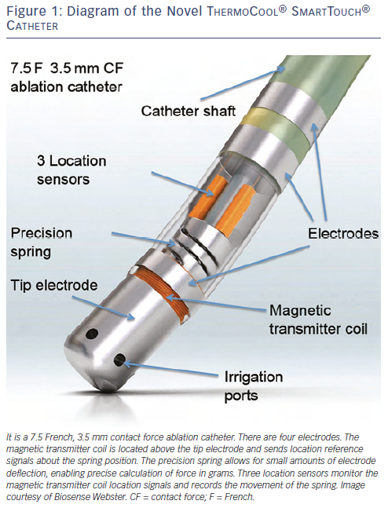
Lin T, Ouyang F, Kuck KH, Tilz RR
Figure 1: Diagram of the Novel ThermoCool® SmartTouch® Catheter
Citation: Arrhythmia & Electrophysiology Review 2013;3(1):44-7
https://doi.org/10.15420/aer.2011.3.1.44

