Slide 1
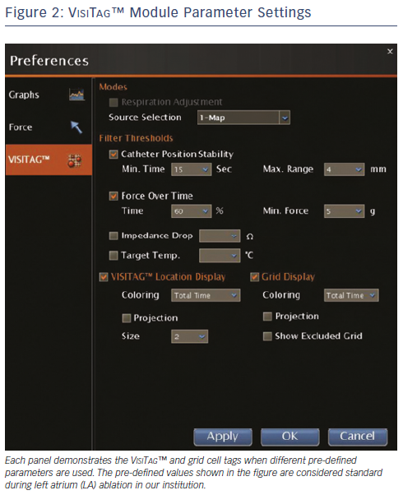
Lin T, Ouyang F, Kuck KH, Tilz RR
Figure 2: VisiTag™ Module Parameter Settings
Citation: Arrhythmia & Electrophysiology Review 2013;3(1):44-7
https://doi.org/10.15420/aer.2011.3.1.44

