Slide 1
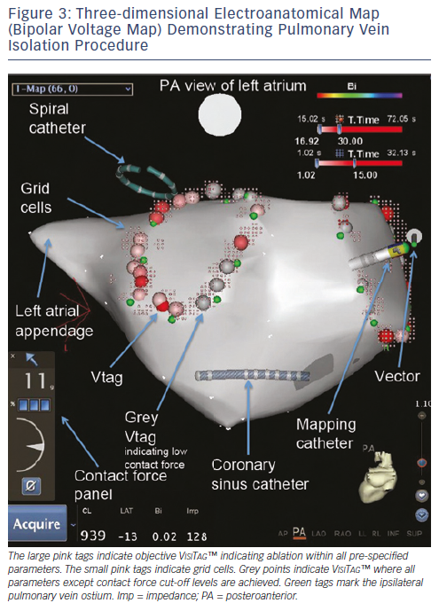
Lin T, Ouyang F, Kuck KH, Tilz RR
Figure 3: Three-dimensional Electroanatomical Map (Bipolar Voltage Map) Demonstrating Pulmonary Vein Isolation Procedure
Citation: Arrhythmia & Electrophysiology Review 2013;3(1):44-7
https://doi.org/10.15420/aer.2011.3.1.44

