Slide 1
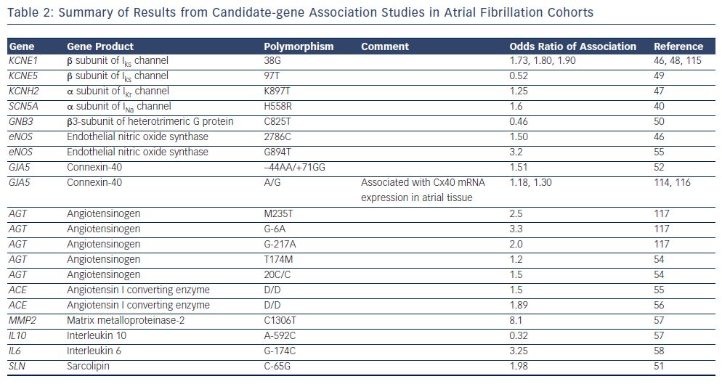
Mahida S
Table 2: Summary of Results from Candidate-gene Association Studies in Atrial Fibrillation Cohorts
Citation: Arrhythmia & Electrophysiology Review 2014;3(2):69–75
https://doi.org/10.15420/aer.2014.3.2.69

