Slide 1
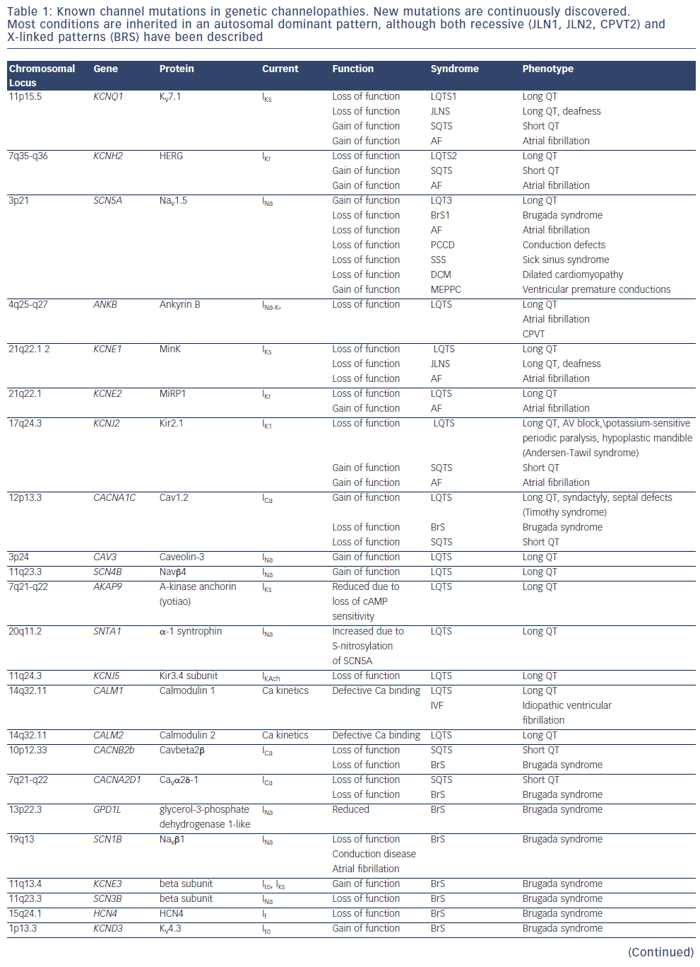
Camm AJ, Gersh BJ, Katritsis DG
Table 1: Known channel mutations in genetic channelopathies. New mutations are continuously discovered. Most conditions are inherited in an autosomal dominant pattern, although both recessive (JLN1, JLN2, CPVT2) and X-linked patterns (BRS) have been described
Citation: Arrhythmia & Electrophysiology Review 2014;3(2):80–4
https://doi.org/10.15420/aer.2014.3.2.80

