Slide 1
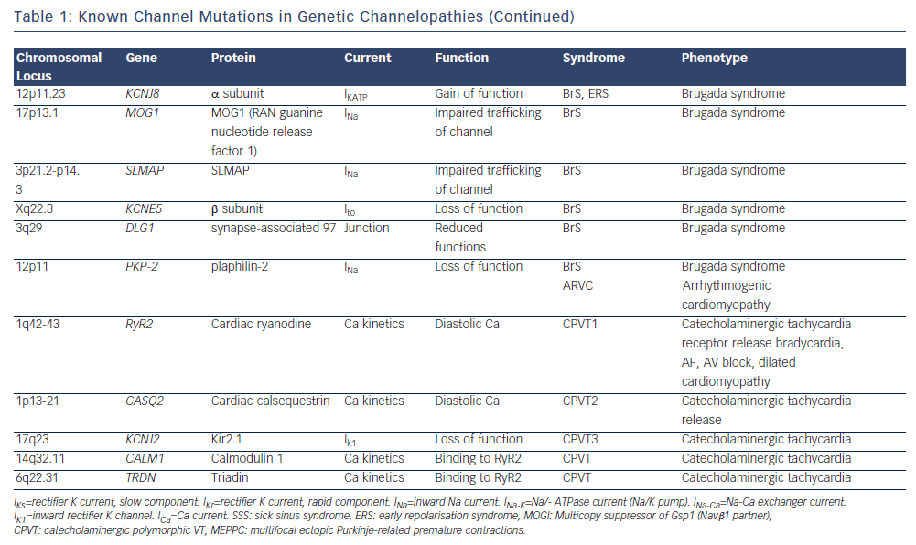
Camm AJ, Gersh BJ, Katritsis DG
Table 1: Known Channel Mutations in Genetic Channelopathies (Continued)
Citation: Arrhythmia & Electrophysiology Review 2014;3(2):80–4
https://doi.org/10.15420/aer.2014.3.2.80

