Slide 1
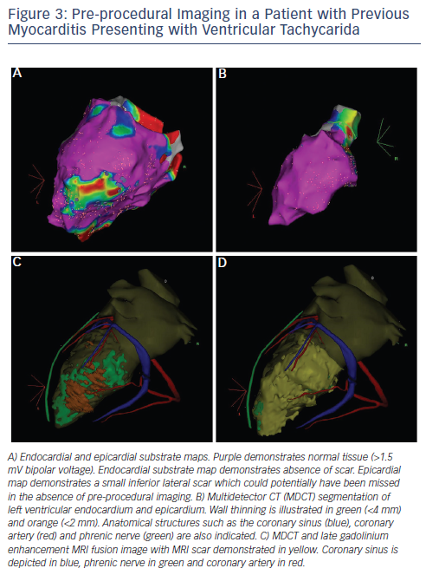
Mahida S, Berte B, Yamashita S, Derval N, Denis A, Shah AJ, Amraoui S, Hocini M, Haissaguerre M, Jaïs P, Sacher F
Figure 3: Pre-procedural Imaging in a Patient with Previous Myocarditis Presenting with Ventricular Tachycarida
Citation: Arrhythmia & Electrophysiology Review 2014;3(2):107–12
https://doi.org/10.15420/aer.2014.3.2.107

