Slide 1
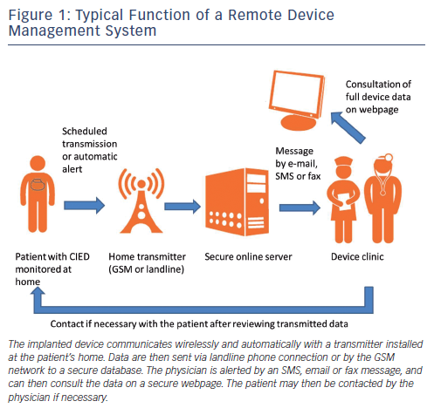
Burri H
Figure 1: Typical Function of a Remote Device Management System
Citation: Arrhythmia & Electrophysiology Review 2013;2(2):95-8
https://doi.org/10.15420/aer.2013.2.2.95

