Slide 1
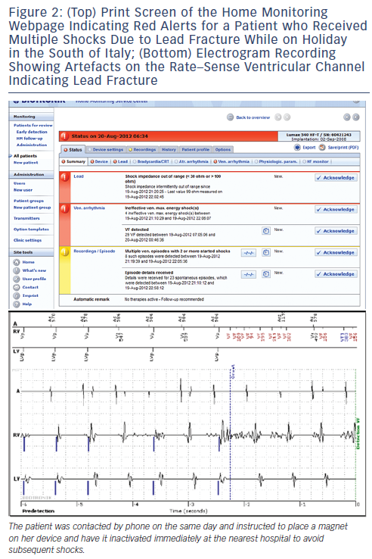
Burri H
Figure 2: (Top) Print Screen of the Home Monitoring Webpage Indicating Red Alerts for a Patient who Received Multiple Shocks Due to Lead Fracture While on Holiday in the South of Italy; (Bottom) Electrogram Recording Showing Artefacts on the Rate–Sense Ventricular Channel Indicating Lead Fracture
Citation: Arrhythmia & Electrophysiology Review 2013;2(2):95-8
https://doi.org/10.15420/aer.2013.2.2.95

