Slide 1
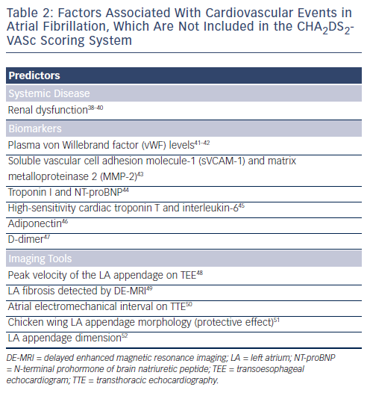
Chao TF, Chiang CE, Chen SA
Table 2: Factors Associated With Cardiovascular Events in Atrial Fibrillation, Which Are Not Included in the CHA2DS2- VASc Scoring System
Citation: Arrhythmia & Electrophysiology Review 2013;2(2):105-8
https://doi.org/10.15420/aer.2013.2.2.105

