Slide 1
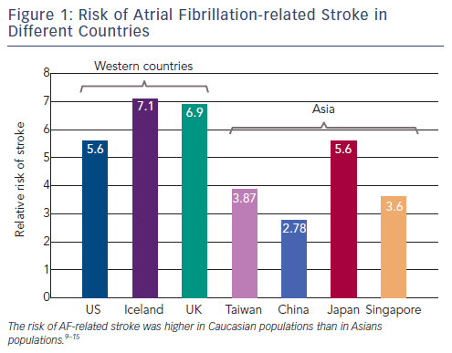
Chao TF, Chiang CE, Chen SA
Figure 1: Risk of Atrial Fibrillation-related Stroke in Different Countries
Citation: Arrhythmia & Electrophysiology Review 2013;2(2):105-8
https://doi.org/10.15420/aer.2013.2.2.105

