Slide 1
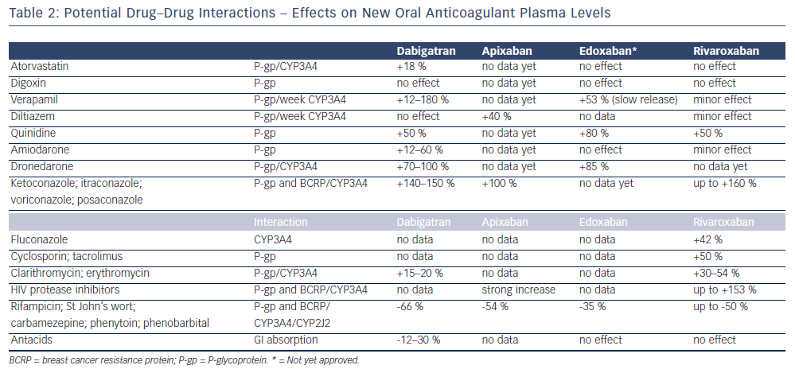
Mountfort K
Table 2: Potential Drug–Drug Interactions – Effects on New Oral Anticoagulant Plasma Levels
Citation: Arrhythmia & Electrophysiology Review 2013;2(2):115-9
https://doi.org/10.15420/aer.2013.2.2.115

