Slide 1

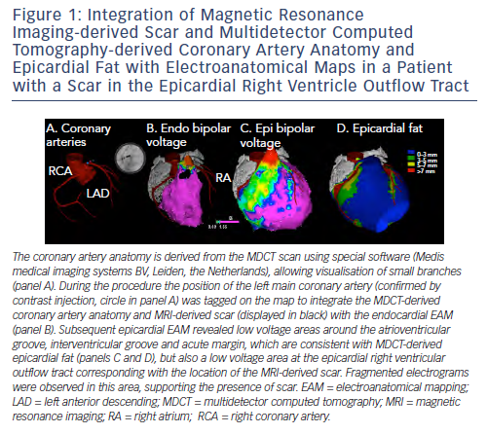
Piers SR, Zeppenfeld K
Figure 1: Integration of Magnetic Resonance Imaging-derived Scar and Multidetector Computed Tomography-derived Coronary Artery Anatomy and Epicardial Fat with Electroanatomical Maps in a Patient with a Scar in the Epicardial Right Ventricle Outflow Tract
Citation: Arrhythmia & Electrophysiology Review 2013;2(2):128-34
https://doi.org/10.15420/aer.2013.2.2.128

