Slide 1
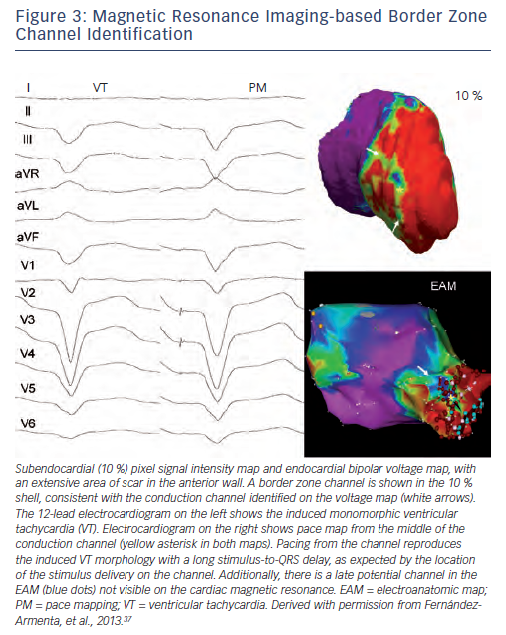
Piers SR, Zeppenfeld K
Figure 3: Magnetic Resonance Imaging-based Border Zone Channel Identification
Citation: Arrhythmia & Electrophysiology Review 2013;2(2):128-34
https://doi.org/10.15420/aer.2013.2.2.128

