Slide 1
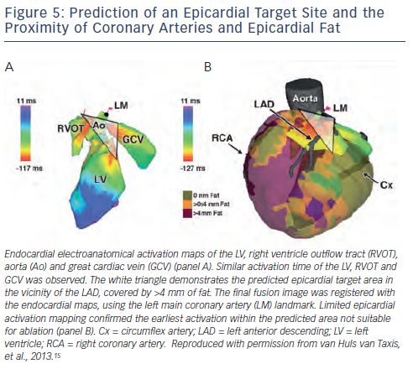
Piers SR, Zeppenfeld K
Figure 5: Prediction of an Epicardial Target Site and the Proximity of Coronary Arteries and Epicardial Fat
Citation: Arrhythmia & Electrophysiology Review 2013;2(2):128-34
https://doi.org/10.15420/aer.2013.2.2.128

