Slide 1
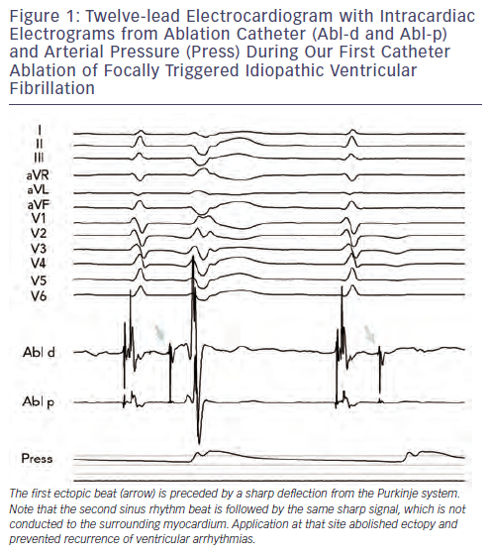
Kautzner J, Peichl P
Figure 1: Twelve-lead Electrocardiogram with Intracardiac Electrograms from Ablation Catheter (Abl-d and Abl-p) and Arterial Pressure (Press) During Our First Catheter Ablation of Focally Triggered Idiopathic Ventricular Fibrillation
Citation: Arrhythmia & Electrophysiology Review 2013;2(2):135-40
https://doi.org/10.15420/aer.2013.2.2.135

