Slide 1
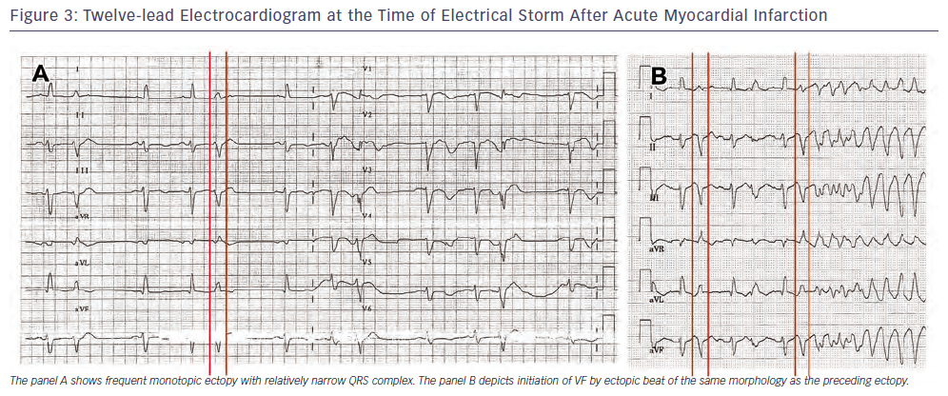
Kautzner J, Peichl P
Figure 3: Twelve-lead Electrocardiogram at the Time of Electrical Storm After Acute Myocardial Infarction
Citation: Arrhythmia & Electrophysiology Review 2013;2(2):135-40
https://doi.org/10.15420/aer.2013.2.2.135

