Slide 1
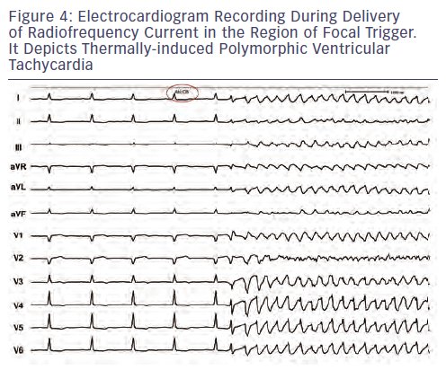
Kautzner J, Peichl P
Figure 4: Electrocardiogram Recording During Delivery of Radiofrequency Current in the Region of Focal Trigger. It Depicts Thermally-induced Polymorphic Ventricular Tachycardia
Citation: Arrhythmia & Electrophysiology Review 2013;2(2):135-40
https://doi.org/10.15420/aer.2013.2.2.135

