Slide 1
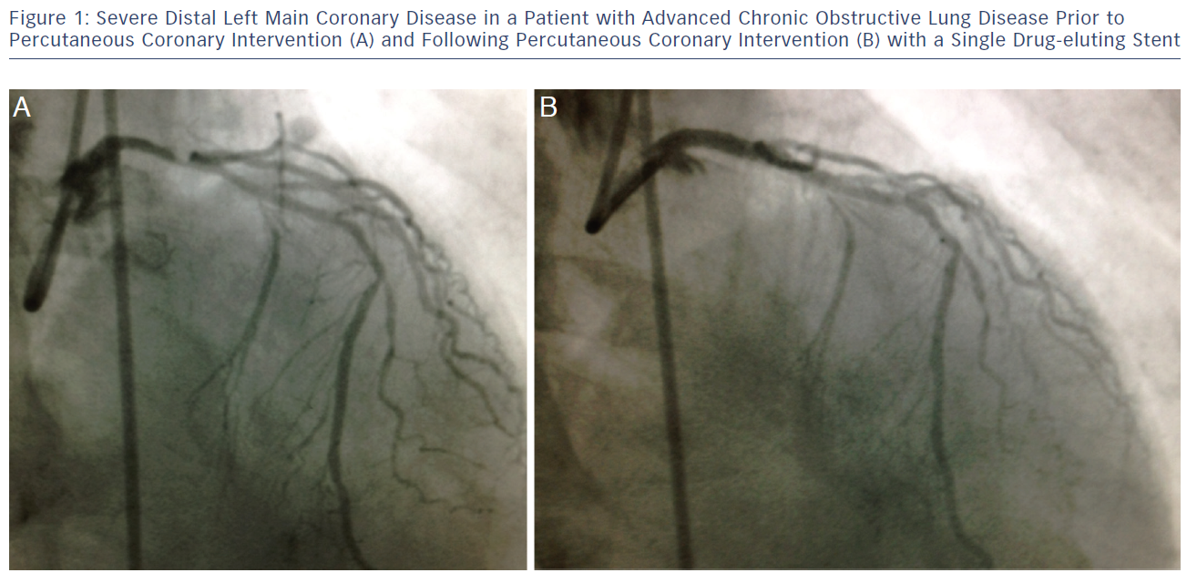
McNulty E
Severe Distal Left Main Coronary Disease In A Patient
Citation: Interventional Cardiology Review 2013;8(1):14–8
https://doi.org/10.15420/icr.2013.8.1.14

