Slide 1
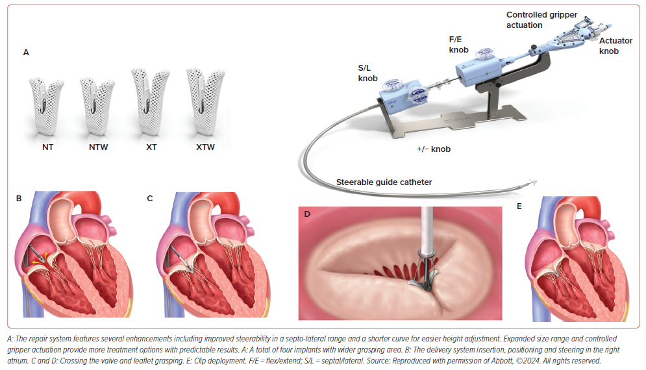
Arnautovic JZ, Ya’Qoub L, Wajid Z, Jacob C, Murlidhar M, Damlakhy A, Walji M
Figure 3: TriClip G4 Transcatheter Tricuspid Valve Repair System
Citation: Interventional Cardiology 2024;19:e20.
https://doi.org/10.15420/icr.2024.08

