Slide 1
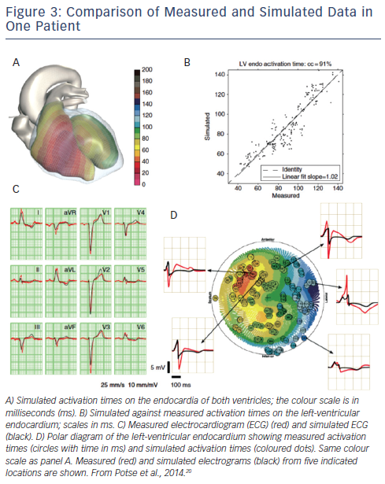
Pluijmert M, Lumens J, Potse M, Delhaas T, Auricchio A, Prinzen F
Figure 3: Comparison of Measured and Simulated Data in One Patient
Citation: Arrhythmia & Electrophysiology Review 2015;4(1):62–7.

