Slide 1
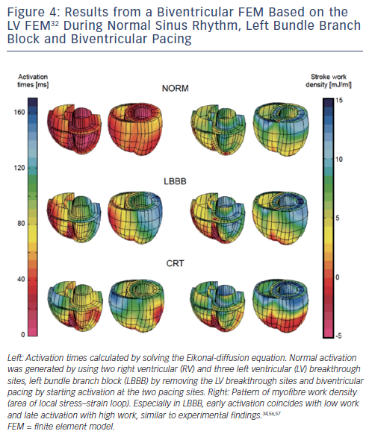
Pluijmert M, Lumens J, Potse M, Delhaas T, Auricchio A, Prinzen F
Figure 4: Results from a Biventricular FEM Based on the LV FEM32 During Normal Sinus Rhythm, Left Bundle Branch Block and Biventricular Pacing
Citation: Arrhythmia & Electrophysiology Review 2015;4(1):62–7.

