Slide 1
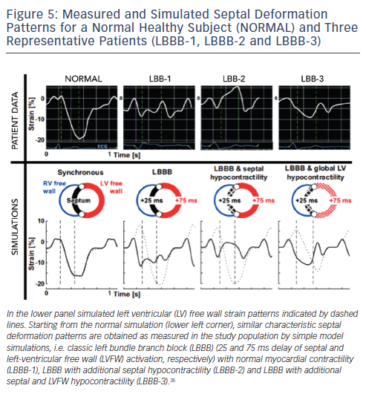
Pluijmert M, Lumens J, Potse M, Delhaas T, Auricchio A, Prinzen F
Figure 5: Measured and Simulated Septal Deformation Patterns for a Normal Healthy Subject (NORMAL) and Three Representative Patients (LBBB-1, LBBB-2 and LBBB-3)
Citation: Arrhythmia & Electrophysiology Review 2015;4(1):62–7.

