Slide 1
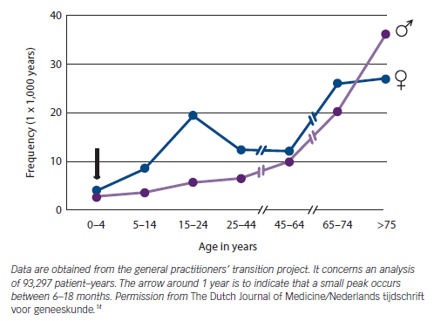
O'Brien H, Kenny RA
Figure 1: Frequency of Fainting as the Reason for Visits to General Practice in The Netherlands
Citation: European Cardiology Review 2014;9(1):28–36
https://doi.org/10.15420/ecr.2014.9.1.28

