Slide 1
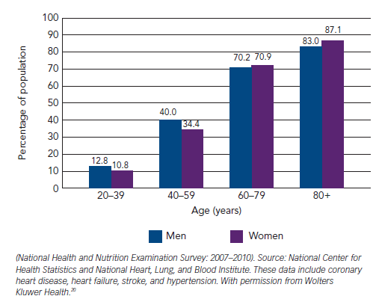
O'Brien H, Kenny RA
Figure 2: Prevalence of Cardiovascular Disease in Adults ≥20 Years of Age by Age and Sex
Citation: European Cardiology Review 2014;9(1):28–36
https://doi.org/10.15420/ecr.2014.9.1.28

