Slide 1
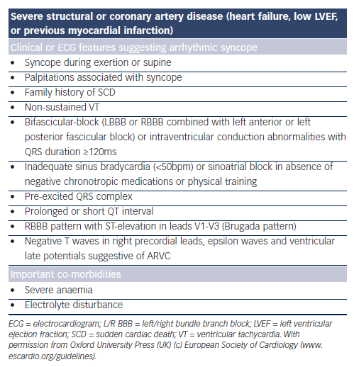
O'Brien H, Kenny RA
Table 5: Risk Stratification – Short-term High-risk Criteria that Require Prompt Hospitalisation or Intensive Evaluation1
Citation: European Cardiology Review 2014;9(1):28–36
https://doi.org/10.15420/ecr.2014.9.1.28

