Slide 1

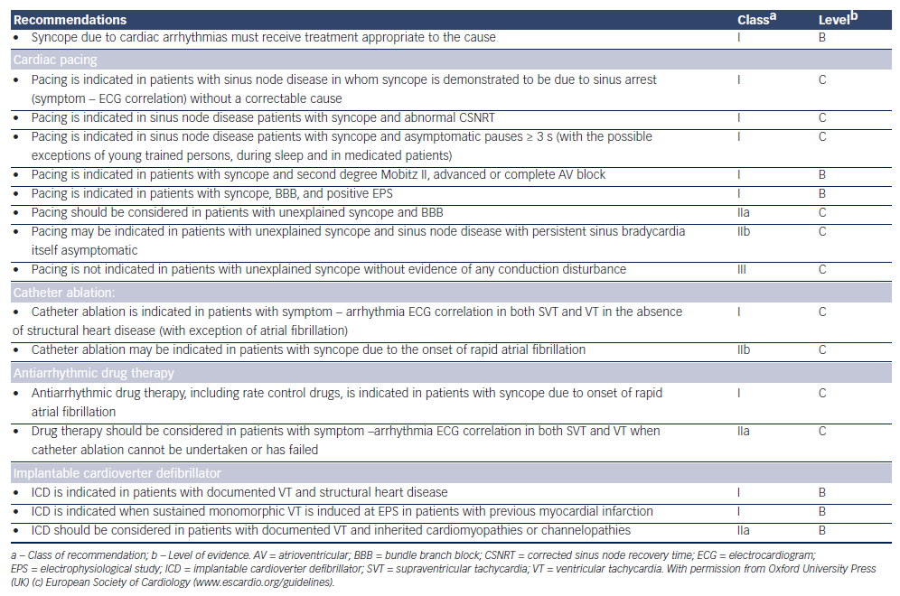
O'Brien H, Kenny RA
Table 6: Recommendations: Treatment of Syncope Due to Cardiac Arrhythmias1
Citation: European Cardiology Review 2014;9(1):28–36
https://doi.org/10.15420/ecr.2014.9.1.28

