Slide 1
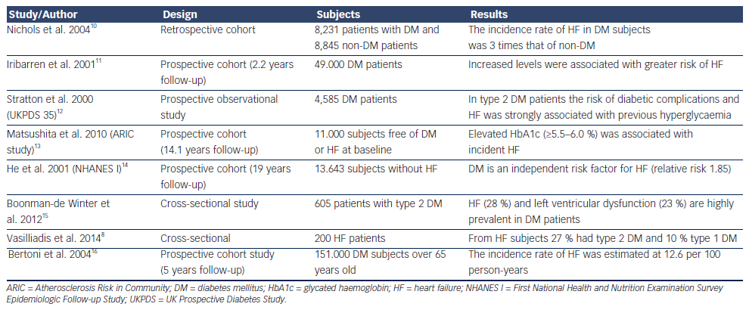
Tousoulis D, Oikonomou E, Siasos G, Stefanadis C
Table 1: Studies Examined the Association between Diabetes Mellitus and Heart Failure
Citation: European Cardiology Review 2014;9(1):37–42
https://doi.org/10.15420/ecr.2014.9.1.37

