Slide 1
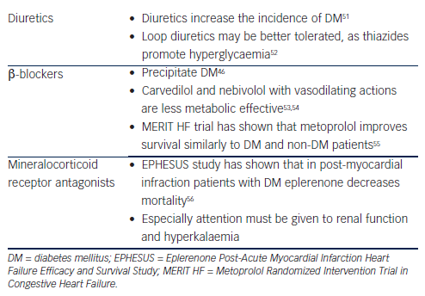
Tousoulis D, Oikonomou E, Siasos G, Stefanadis C
Table 2: Key Points in the Management of Heart Failure in Patients with Diabetes Mellitus
Citation: European Cardiology Review 2014;9(1):37–42
https://doi.org/10.15420/ecr.2014.9.1.37

