Slide 1
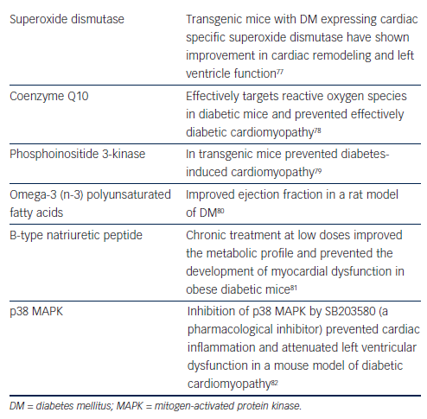
Tousoulis D, Oikonomou E, Siasos G, Stefanadis C
Table 4: Non-conventional and Experimental Treatment of Diabetic Cardiomyopathy
Citation: European Cardiology Review 2014;9(1):37–42
https://doi.org/10.15420/ecr.2014.9.1.37

