Slide 1
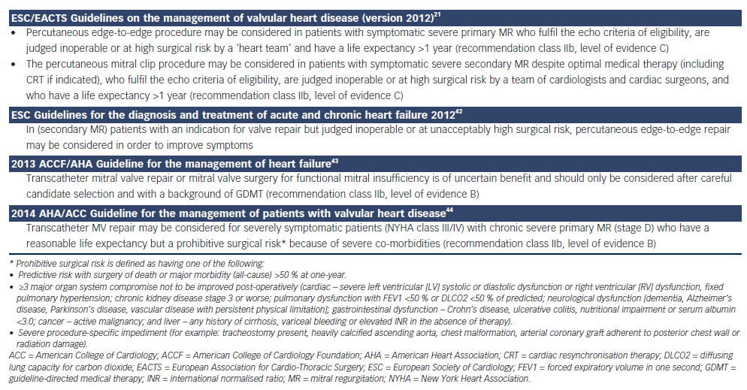
Alegria-Barrero E, Franzen OW
Table 1: Guidelines Recommendations for Percutaneous Edge-to-Edge Mitral Valve Repair
Citation: European Cardiology Review 2014;9(1):49–53
https://doi.org/10.15420/ecr.2014.9.1.49

